Slide 1
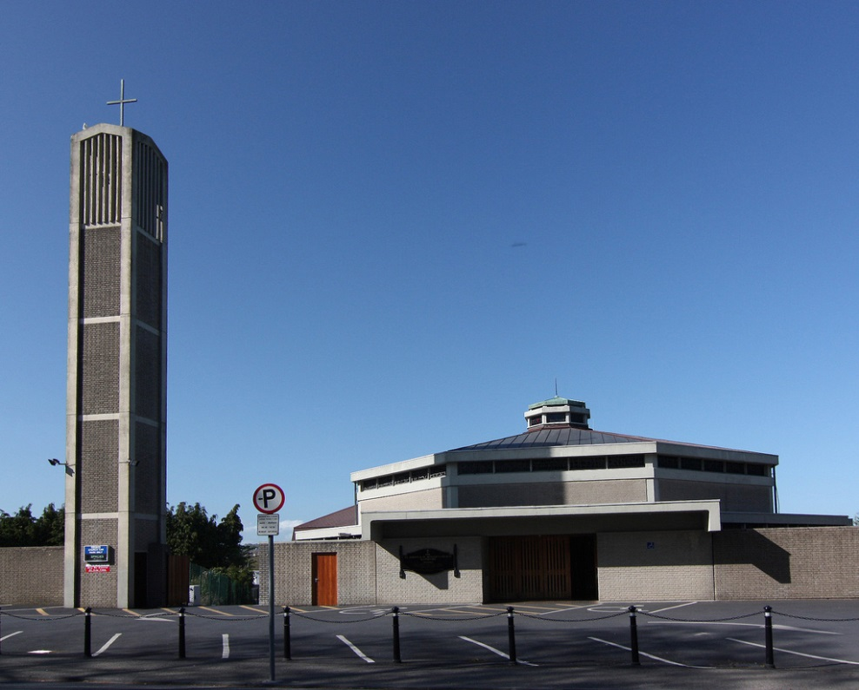
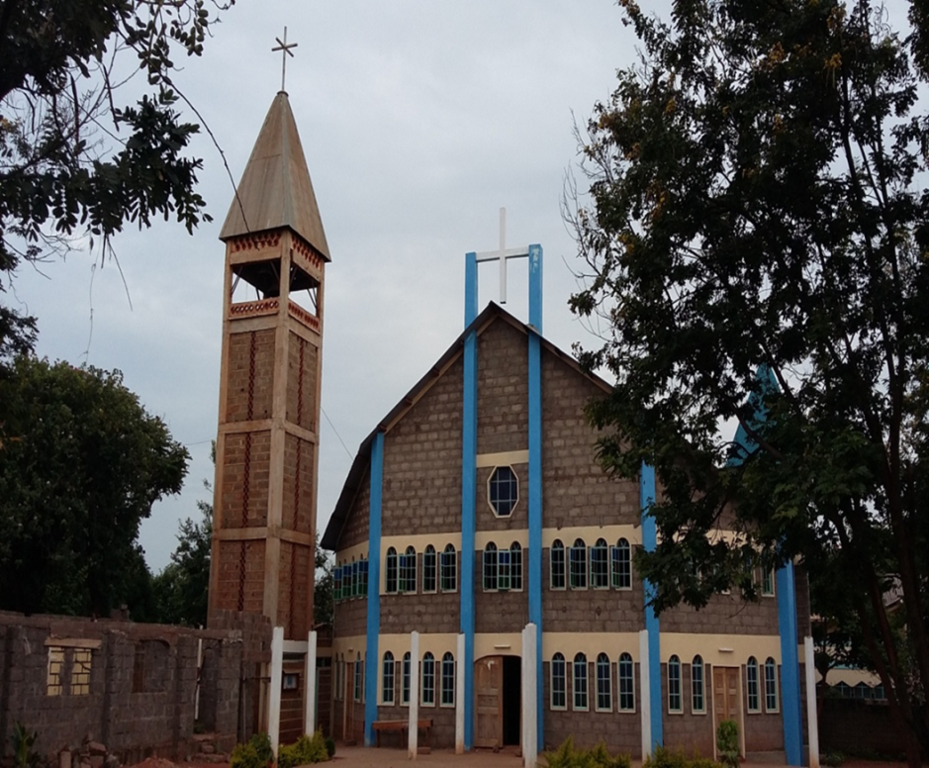
St. Joseph, St. Benildus & St. Mary’s Parish
Partnership with…
Ishiara Parish, Kenya

Slide 2
The presence of the Augustinians is dated back to the early 90’s. Since then the friars have been running the parish and taking care of the pastoral, spiritual, development and educational.
There has been a gradual growth of the friars working in this community. From the beginning, it used to be one or two friars, but presently, there are 5 friars and all are engaged in different activities.
THE MAIN PARISH CHURCH

Slide 3
Ishiara is in an ASAL area; therefore it is
agro-pastoralist community.
The annual rainfall lasts for three months and sometimes less and this makes the community vulnerable to famine and loss of livestock due long spell of drought. Being ASAL water is a problem. The Order has been receiving support from Trocaire (Caritas Ireland) since 1996 up to date. Tremendous change is being experienced since the irrigation water project was initiated 4 years ago that targeted 700 households.

Slide 4
The parish community has 20 prayer houses.
15 catholic sponsored primary schools,
5 secondary schools and 27 jumuiyas.
Each of priest celebrates 3 masses every Sunday. Baptism of infants is twice a year. Spiritual groups: CWA, CMA, ST. Rita, youths and PMC
(these have made pilgrimages to different spiritual places)
Jumuiyas have different days they meet and once a month Mass is celebrated for them.

Slide 5
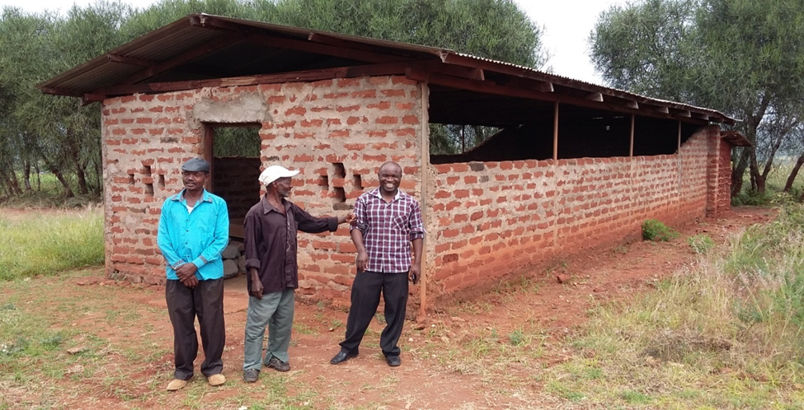
SOME OF THE 20 PRAYER HOUSE
NTHIGIRANI PRAYER HOUSE

Slide 6
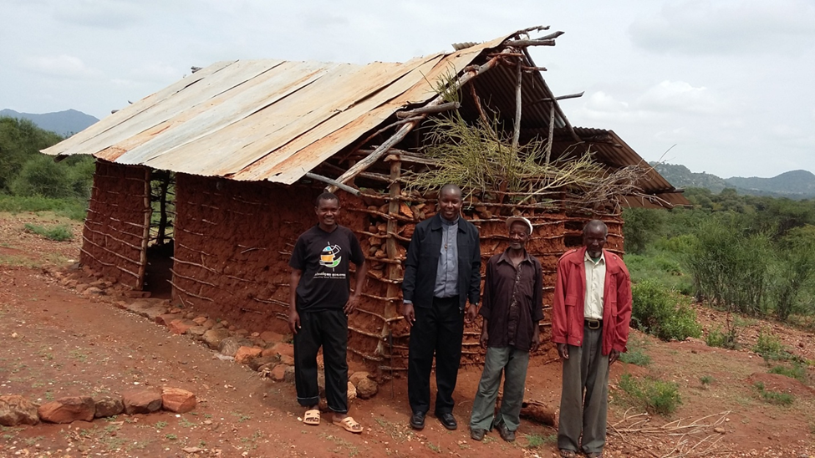
KIAMATHUKU PRAYER HOUSE

Slide 7
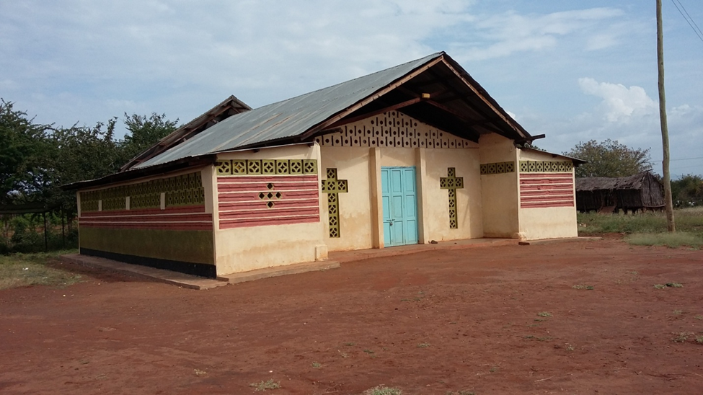
KYENIRE

Slide 8
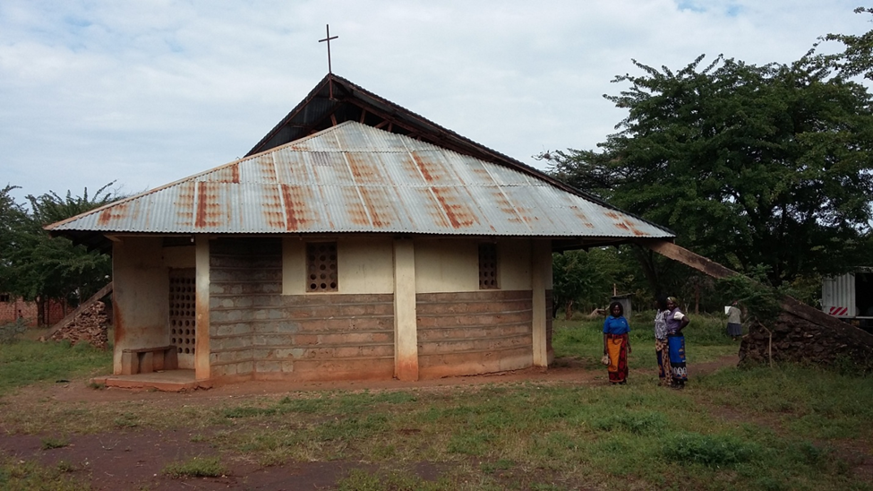
MANG’OTE

Slide 9
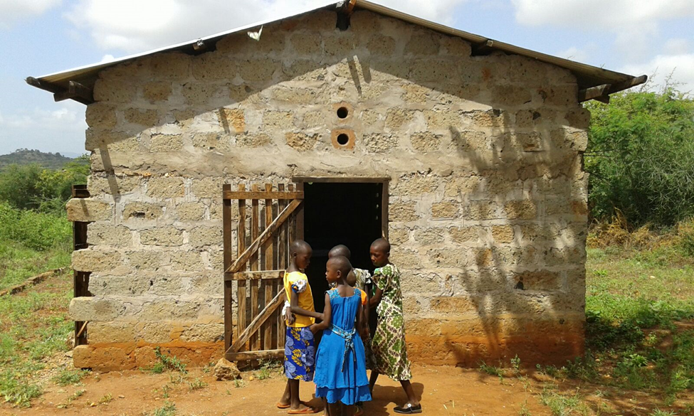
MBACI

Slide 10
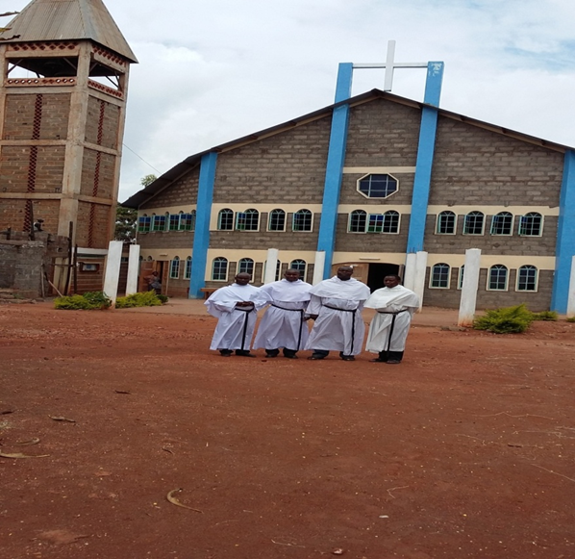
ISHIARA O.S.A COMMUNITY WITH THE DELEGATION SUPERIOR DURING SPECIAL VISITATION ON 19TH JANUARY 2016

Slide 11
Challenges faced by O.S.A community in Ishiara
The outstations are many and the access roads are poor.
Lack of enough vehicles for movement in the parish.
Financial constraints.

Slide 12
Possible Future prospects for O.S.A mission in Ishiara
1. Acquiring land and building an Augustinian boys secondary school.
2. Rental houses
3. Commercial poultry
4. Retreat centre
5. Computer school
6. Fish pond
7. Clinic/Dispensary in one of the outstations
8. Keeping local goats.

